Slide 1
Introduction to TypeScript

Slide 2
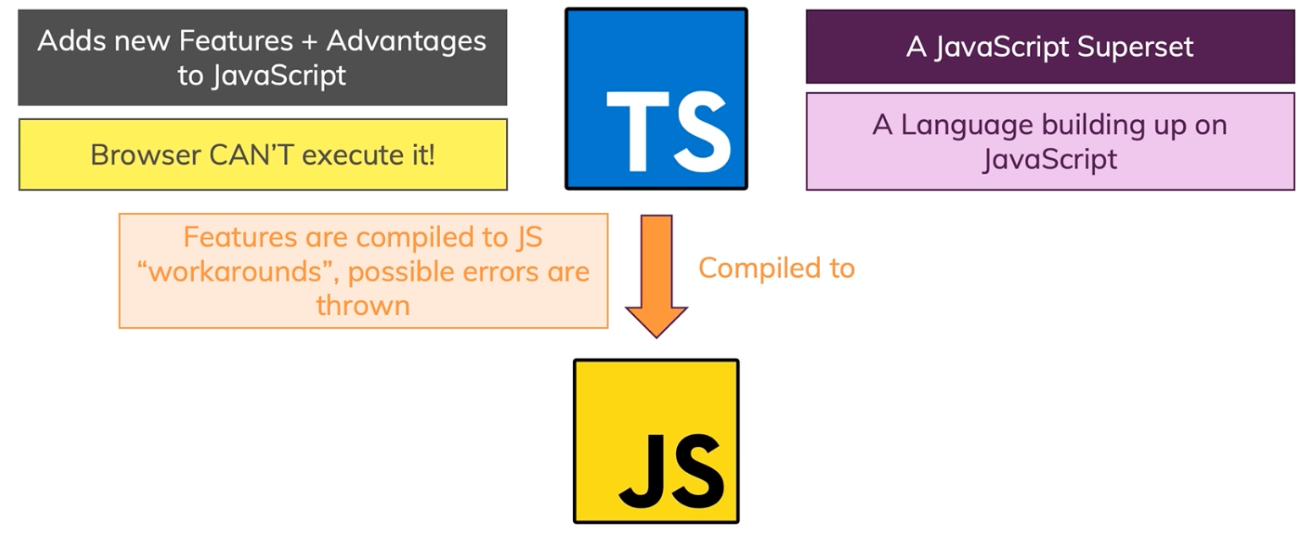
What is TypeScript

Slide 3
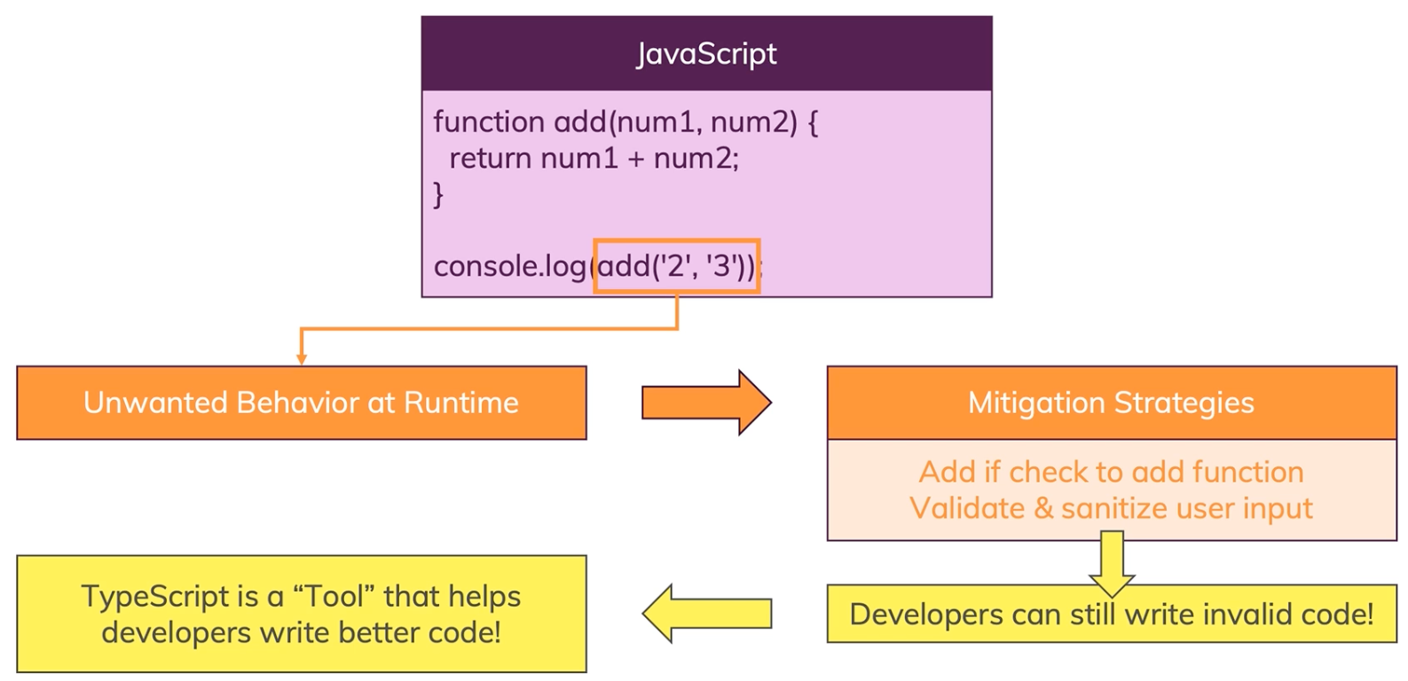
Why TypeScript

Slide 4
Installing TypeScript
Install NodeJS
Install TypeScript using NPM
Lastly, install VS Code.

Slide 5
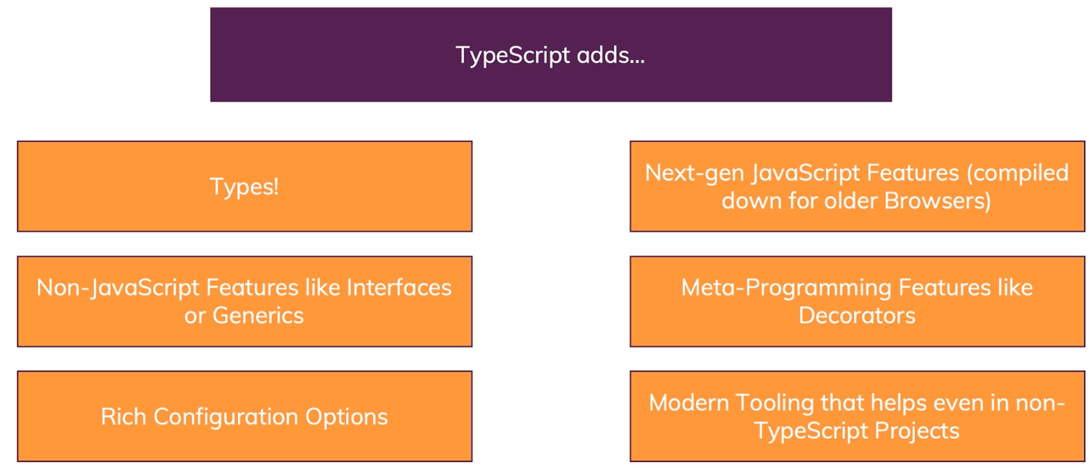
TypeScript Overview

